Slide 1
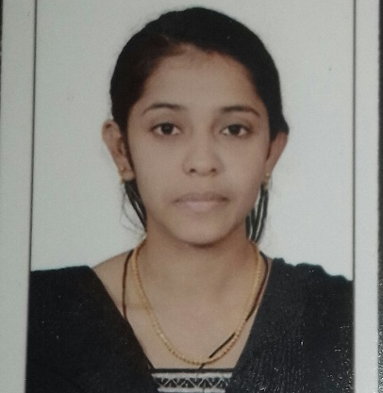


Uzma Tahaseen
Analyst/Software Engineer
Bachelor of Technlogy, Computer Science and Engineering : 2015-2019
Skills
C# | Basics, OOPS, Exception Handling ,Arrays ,Collection and Generics, Delegates and Events, File Io and Serialization.
.NET Framework | Architecture which includes CTS,CLS,FCL,BCL and CLR.
Ado.net | Basics Architecture
Database | Basic SQL
Tools | GIT
UI Technology | HTML5 and CSS
Add On Skills | Communication Skills, Team Management, UI Designing(Sketching).
Bangalore
UZMA.TAHASEEN@CAPGEMINI.COM
+919945858025
A4
Full Stack Developer
Understanding of RDMS concepts using SQL Server.
Practical understanding of C# and SQL concepts using Visual Studio and SQL Server
Hands on experience in developing applications using .NET Framework, ADO.NET and SQL Server.
Proficient in creating Single page Web Application in React.
Understanding of HTML5 and CSS.
Currently completing the course on Azure Fundamentals.
Completed case study on Pharmacy Management System which is used to manage the drugs as well as supplier details and user can also login and order drugs whereas admin will be verify that order.
https://github.com/uzusara

